Slide 1
PROTECT AND RESTORE ECOSYSTEMS

Slide 2
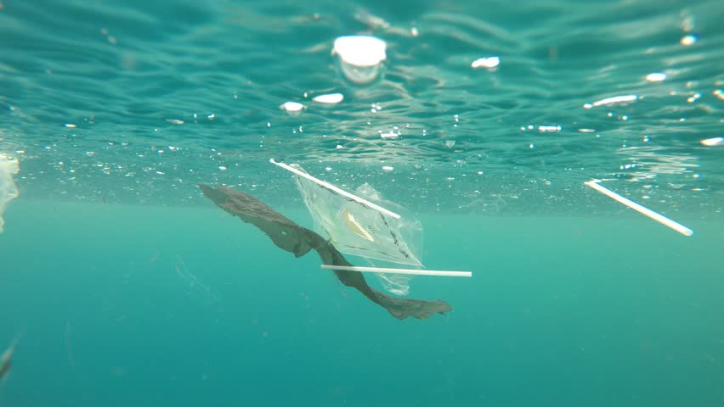
Problem statement
Marine life is dying due to plastic pollution and lack of awareness

Slide 3
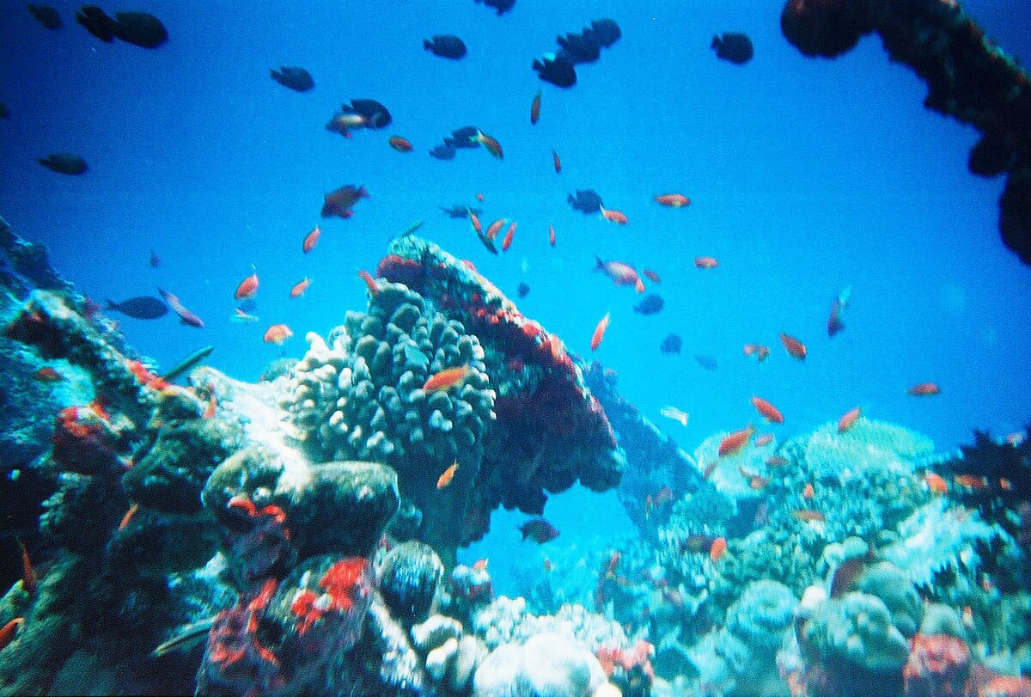
subtopic we are focusing on
To cleanup the plastic pollution and other wastes.

Slide 4
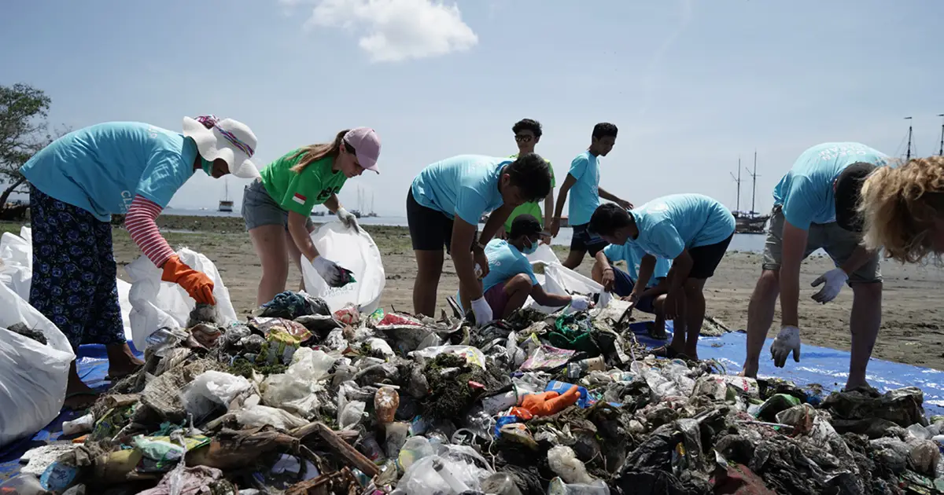
Our solution idea
An AI-powered drone and satellite-based monitoring system that detects floating marine litter and sends live location alerts to nearby cleanup teams or ships
This Photo by Unknown Author is licensed under CC BY-NC-ND

Slide 5
How it works
1. Drones fly over coastlines and oceans.
2. Cameras capture live video of the surface.
3. AI (image recognition) identifies plastic waste or oil spills.
4. The system maps the area and sends an alert to cleanup units or NGOs.

Slide 6
Key features
1.🌍 AI Vision System: Detects floating debris, nets, and oil.
2.📡 Real-Time Alerts: Sends GPS coordinates to cleanup networks.
3.🗺️ Dashboard: Displays live ocean pollution heatmap.
4.🤖 Self-Charging Drones: Use solar power for long-term missions.

Slide 7
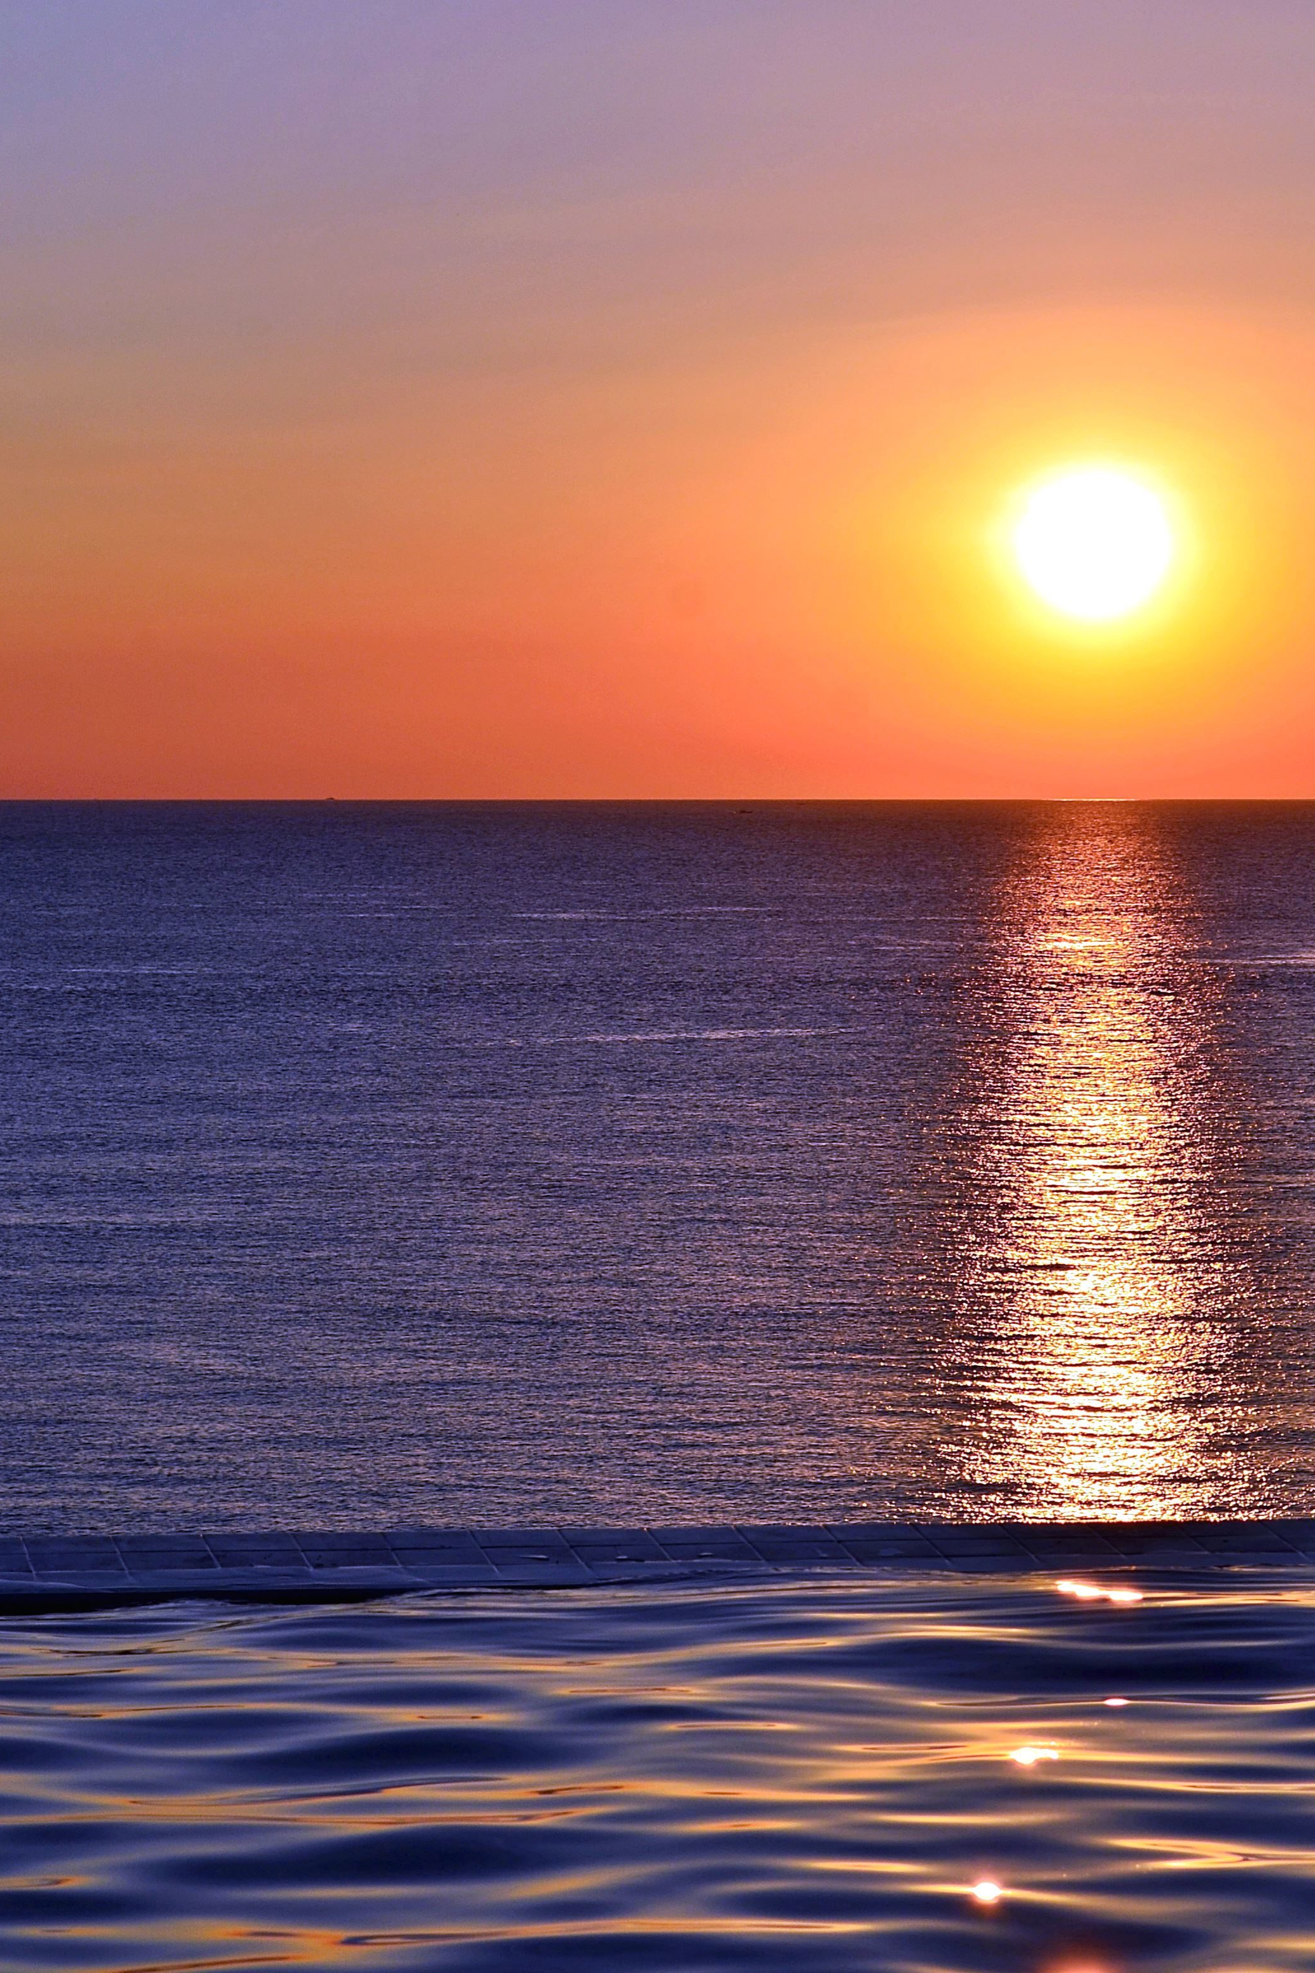
impact
1.Faster detection = quicker cleanup.
2.Protects marine life (turtles, dolphins, coral reefs).
3.Data helps governments and NGOs plan cleanup operations better.
4.Inspires citizen reporting and awareness.

Slide 8
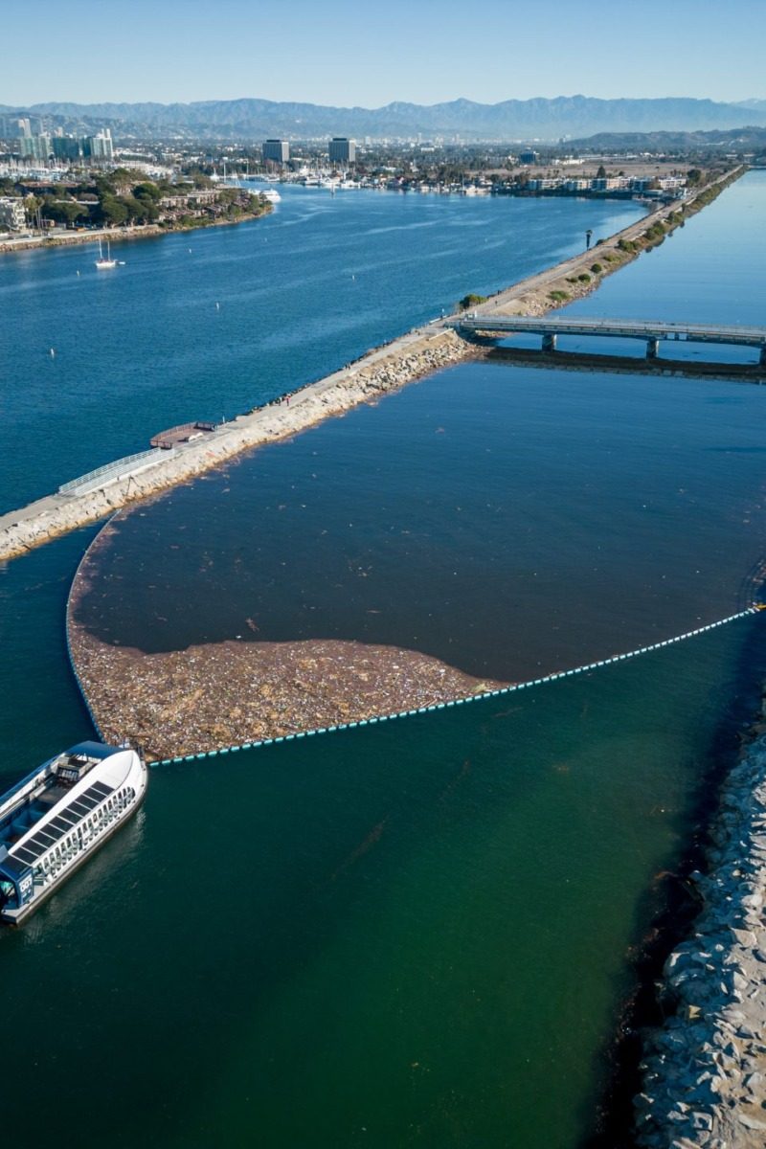
Future enhancements
1. Use underwater drones to detect deep-sea waste.
2. Add AI prediction to forecast pollution spread.
3. Integrate community app for citizens to report beach litter.
This Photo by Unknown Author is licensed under CC BY

Slide 9
Thank you

